Slide 1
Unsupervised Learning

Slide 2
Supervised learning vs. unsupervised learning
Supervised learning: discover patterns in the data that relate data attributes with a target (class) attribute.
These patterns are then utilized to predict the values of the target attribute in future data instances.
Unsupervised learning: The data have no target attribute.
We want to explore the data to find some intrinsic structures in them.

Slide 3
Clustering
Clustering is a technique for finding similar groups in data, called clusters. i.e.,
It groups data instances that are similar to (near) each other in one cluster and data instances that are very different (far away) from each other into different clusters.
Clustering is often called an unsupervised learning task as no class values denoting an a priori grouping of the data instances are given, which is the case in supervised learning.

Slide 4

An illustration
+
+++
We see that there are two natural groups or “clusters”

Slide 5
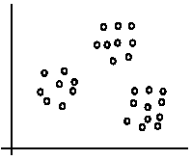
An illustration
The data set has three natural groups of data points, i.e., 3 natural clusters.

Slide 6
What is clustering for?
Let us see some real-life examples
Example 1: groups people of similar sizes together to make “small”, “medium” and “large” T-Shirts.
Tailor-made for each person: too expensive
Example 2: In marketing, segment customers according to their similarities
To do targeted marketing.

Slide 7
What is clustering for? (cont…)
Example 3: Given a collection of text documents, we want to organize them according to their content similarities,
To produce a topic hierarchy
In fact, clustering is one of the most utilized data mining techniques.
It has a long history, and used in almost every field, e.g., medicine, psychology, botany, sociology, biology, archeology, marketing, insurance, libraries, etc.
In recent years, due to the rapid increase of online documents, text clustering becomes important.

Slide 8
Aspects of clustering
A clustering algorithm
Partitional clustering
Hierarchical clustering
Density based clustering
---
A distance (similarity, or dissimilarity) function
Clustering quality
Inter-clusters distance ⇒ maximized
Intra-clusters distance ⇒ minimized

Slide 9
K-means clustering
K-means is a partitional clustering algorithm
Let the set of data points (or instances) D be
{x₁, x₂, …, x_{n}},
where x_{i} = (x_{i1}, x_{i2}, …, x_{ir}) is a vector in a real-valued space X ⊆ R^{r}, and r is the number of attributes (dimensions) in the data.
The k-means algorithm partitions the given data into k clusters.
Each cluster has a cluster center, called centroid.
k is specified by the user

Slide 10
K-means algorithm
Given k, the k-means algorithm works as follows:
Randomly choose k data points (seeds) to be the initial centroids, cluster centers
Assign each data point to the closest centroid
Re-compute the centroids using the current cluster memberships.
If a convergence criterion is not met, go to 2).

Slide 11
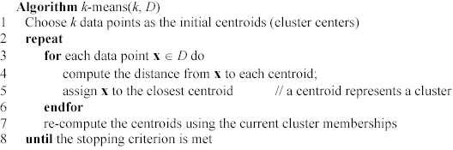
K-means algorithm – (cont …)

Slide 12
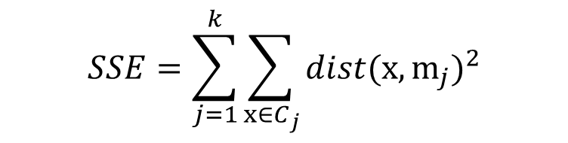
Stopping/convergence criterion
no (or minimum) re-assignments of data points to different clusters,
no (or minimum) change of centroids, or
minimum decrease in the sum of squared error (SSE),
C_{j} is the j^{th} cluster, m_{j} is the centroid of cluster C_{j} (the mean vector of all the data points in C_{j}), and dist(x, m_{j}) is the distance between data point x and centroid m_{j}.
$$SSE=\sum_{j=1}^{k}{\sum_{x∈C_{j}}{dist(x,m_{j})^{2}}}$$

Slide 13
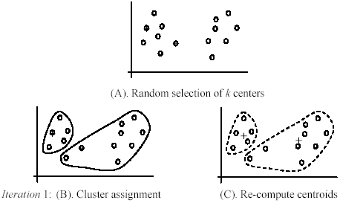
An example

Slide 14
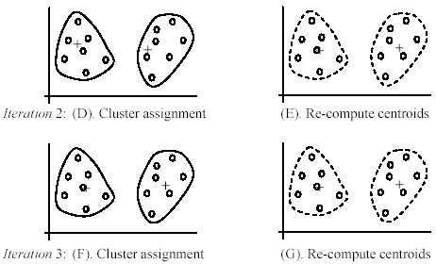
An example (cont …)

Slide 15


An example distance function
The k-means algorithm can be used for any application data set where the mean can be defined and computed. The mean of cluster is computed with:
Where |C_{j}| is the number of points in the cluster C_{j.} the distance from one point x_{i} to a mean m_{j} (centroid) is computed with:

Slide 16
Strengths of k-means
Strengths:
Simple: easy to understand and to implement
Efficient: Time complexity: O(tkn),
where n is the number of data points,
k is the number of clusters, and
t is the number of iterations.
Since both k and t are small. k-means is considered a linear algorithm.
K-means is the most popular clustering algorithm.

Slide 17
Weaknesses of k-means
The algorithm is only applicable if the mean is defined.
For categorical data, k-mode - the centroid is represented by most frequent values.
The user needs to specify k.
The algorithm is sensitive to outliers
Outliers are data points that are very far away from other data points.
Outliers could be errors in the data recording or some special data points with very different values.

Slide 18
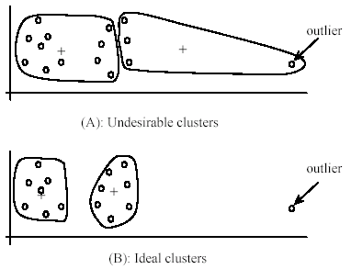
Weaknesses of k-means: Problems with outliers

Slide 19
Weaknesses of k-means: To deal with outliers
One method is to remove some data points in the clustering process that are much further away from the centroids than other data points.
To be safe, we may want to monitor these possible outliers over a few iterations and then decide to remove them.
Another method is to perform random sampling. Since in sampling we only choose a small subset of the data points, the chance of selecting an outlier is very small.
Assign the rest of the data points to the clusters by distance or similarity comparison

Slide 20
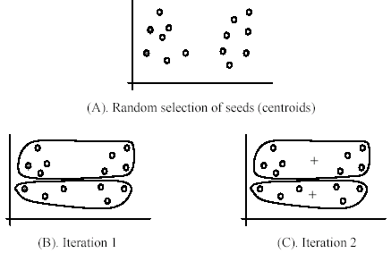
Weaknesses of k-means (cont …)
The algorithm is sensitive to initial seeds.

Slide 21
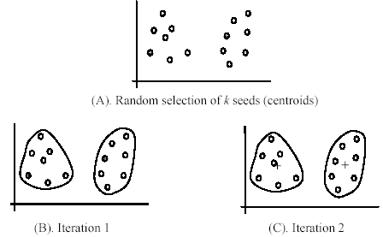
Weaknesses of k-means (cont …)
If we use different seeds: good results

Slide 22
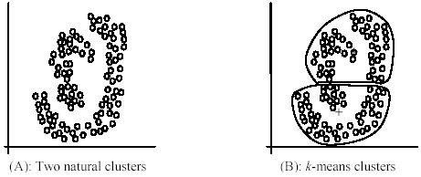
Weaknesses of k-means (cont …)
The k-means algorithm is not suitable for discovering clusters that are not hyper-ellipsoids (or hyper-spheres).
+

Slide 23
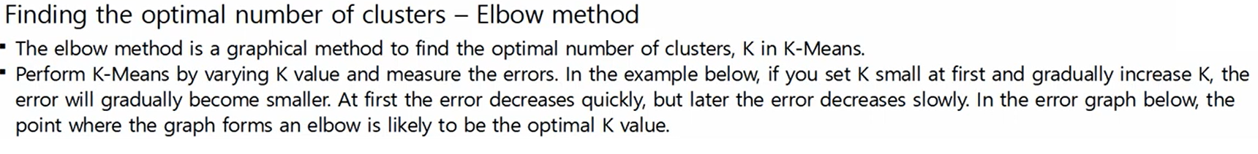
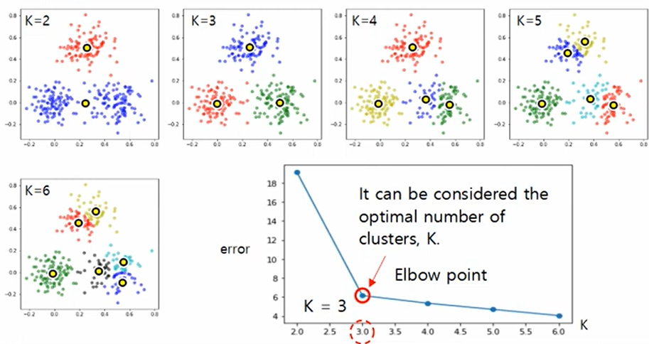

Slide 24
K-means++ Algorithm

Slide 25
K-means++ Algorithm

